Slide 1

Group Id:
SGH000840
Faculty Guide:
Mr. Parth Shah
Group Members:
Yash Bajaj
Saumya Bhatt
Siddhant Sinha
Jay Patel
Nency Borad
Surbhi Pokharna
Hinali Patadia

Slide 2
Voice Assistant for Visually Impaired

Slide 3
Object Detection
Object Detection is a field of Computer Vision that detects instances of semantic objects in images/videos (by creating bounding boxes around them in our case). We can then convert the annotated text into voice responses and give the name of the objects in the person/camera’s view.

Slide 4
Technologies Used
Machine Learning
IOT
Deep Learning

Slide 5
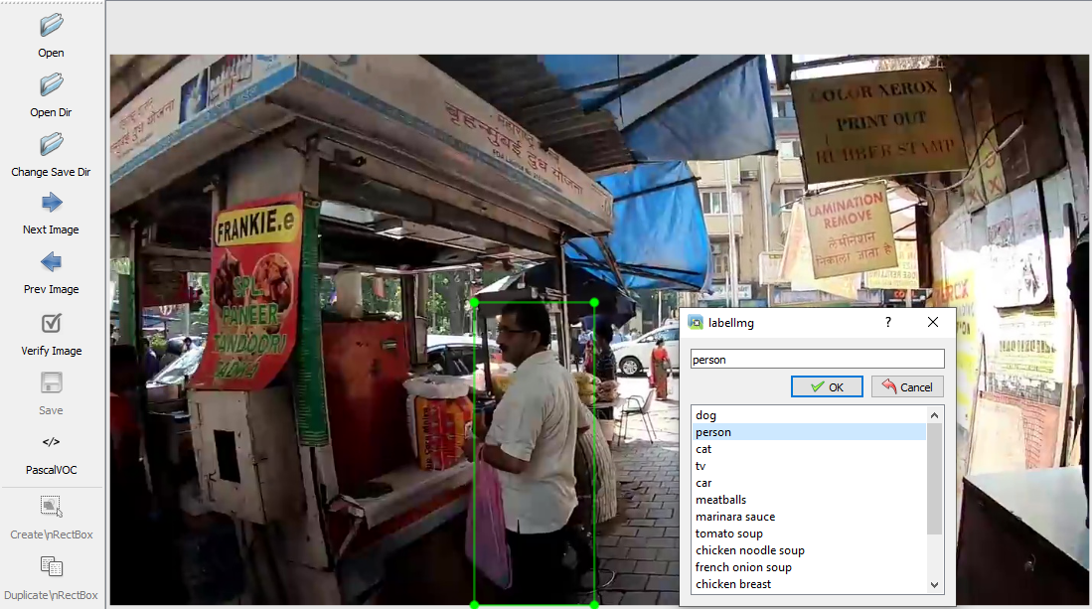
1. Training Data
The model is trained with the Common Objects in dataset.
Image shows training the model with characteristics of person.

Slide 6
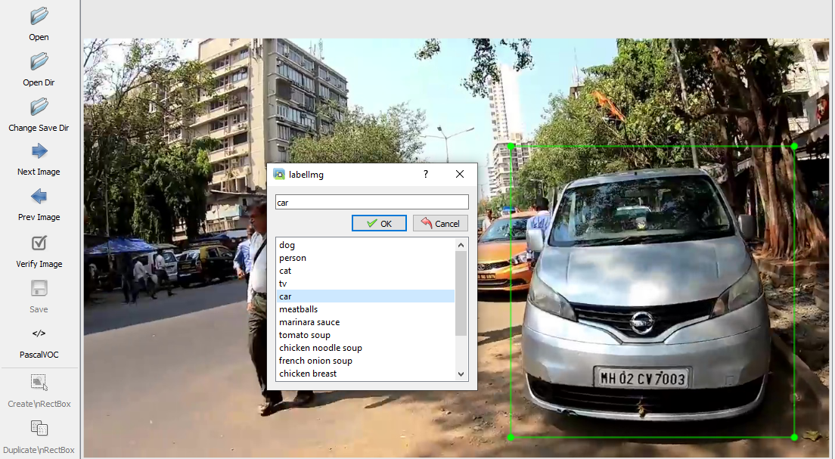
Fig: Above image shows training the model with features of car.

Slide 7
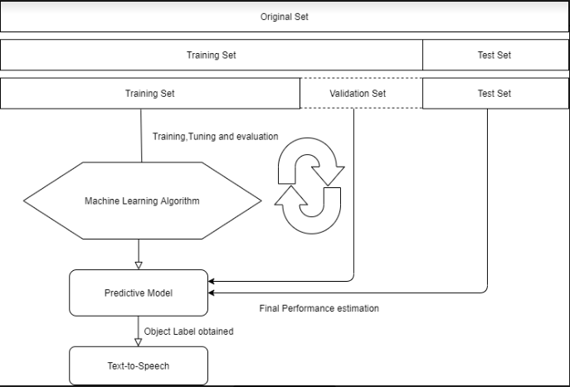
2. Model
The model here is the algorithm that runs through a variation of an extremely complex Convolutional Neural Network architecture.

Slide 8
3. Input Data
We have used our webcam to test images as frames to this trained model.
We can then send the text description to the Google Text-to-Speech using the gTTS package.

Slide 9
4. Output
We will obtain the coordinates of the bounding box of every object detected in our frames, overlay the boxes on the objects detected and return the stream of frames as a video playback.
We will also schedule to get a voice feedback on the 1st frame by taking the object whose accuracy is highest e.g. “person is detected”.

Slide 10
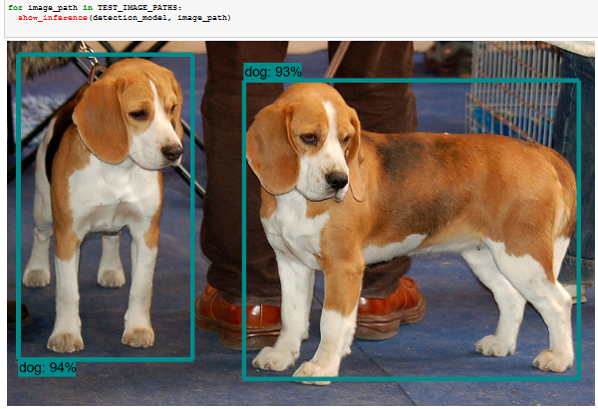
Initially, We implemented algorithm on static image of Dog. The value shows the percentage of accuracy of object.

Slide 11
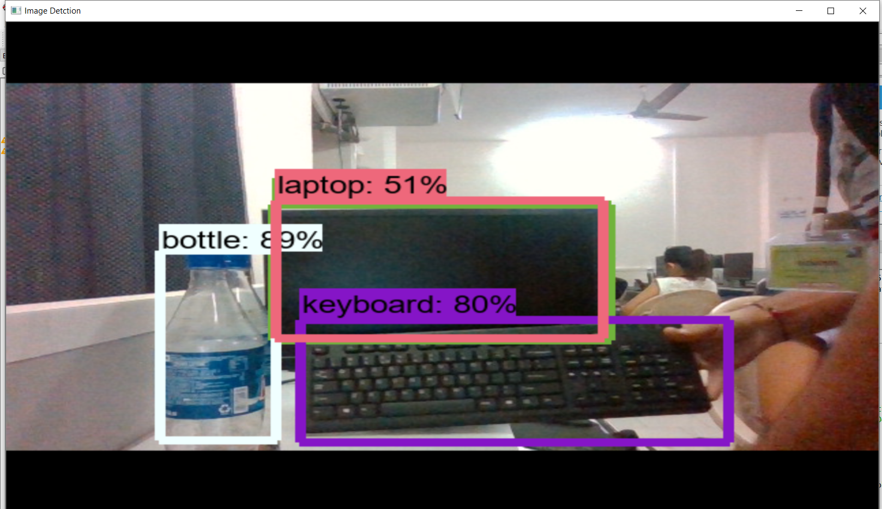
We then implemented the algorithm on real-world objects. The image below shows the detection of bottle, keyboard and laptop.

Slide 12
Future Work
We will integrate NodeMCU with Python for calculating the distance of the objects from the WebCam.
Also, our product will guide blind person to follow the best path to reach the destination.
We will use alternative way to reduce the complexity of the model.

Slide 13
THANK YOU

